Slide 1
Computer Organization and Architecture
William Stallings
8th Edition
Chapter 1
Introduction

Slide 2
Architecture & Organization
Architecture is those attributes visible to the programmer, or those attributes that have a direct impact on the logical execution of a program.
      Instruction set, number of bits used for data representation, I/O mechanisms, addressing techniques.
Organization is how features are implemented, or the operational units and their interconnections that realize the architecture specification.
      - Control signals, interfaces, memory technology.

Slide 3
Forces on Computer Architecture
Technology
Programming
Languages
Applications
Computer
Architecture
Operating
Systems
History

Slide 4
Architecture & Organization
- All Intel x86 family share the same basic architecture.
- The IBM System/370 family share the same basic architecture.
- Organization differs between different versions.
Computer Architecture =
Instruction Set Architecture +
Machine Organization

Slide 5
Architecture & Organization
However, because a computer organization must be designed to implement a particular architecture specification, a through treatment of organization requires a detailed examination of architecture as well.
software
instruction set
hardware

Slide 6
Structure & Function
Structure is the way in which components relate to each other.
The Five Classic Components of a Computer
  Input (mouse, keyboard, …)
  Output (display, printer, …)
  Memory
    main (DRAM), cache (SRAM)
    secondary (disk,
    CD, DVD, …)
  Datapath
  Control
Function is the operation of individual components as part of the structure.
Processor
(CPU)

Slide 7
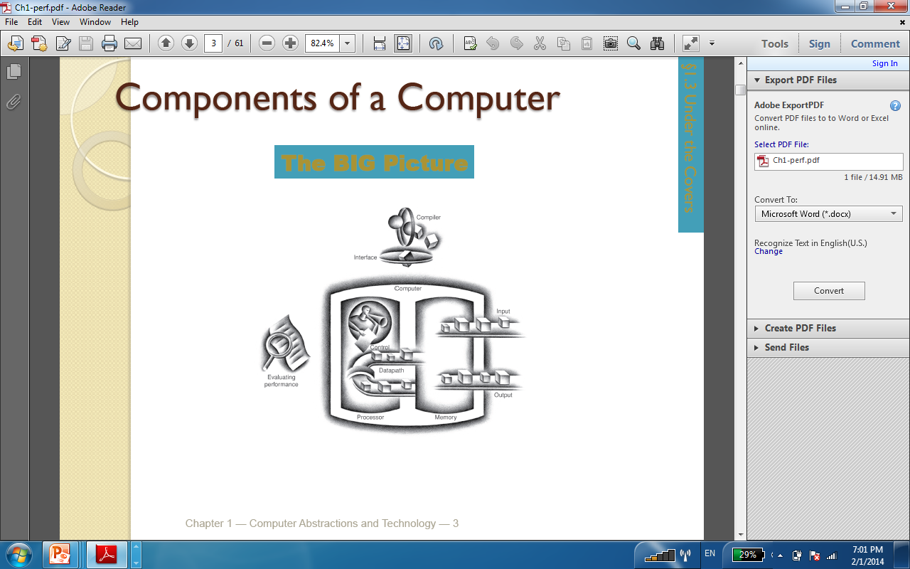
The Five Classic Components of a Computer

Slide 8
Function
All computer functions are:
  Data processing
  Data storage
  Data movement
  Control

Slide 9
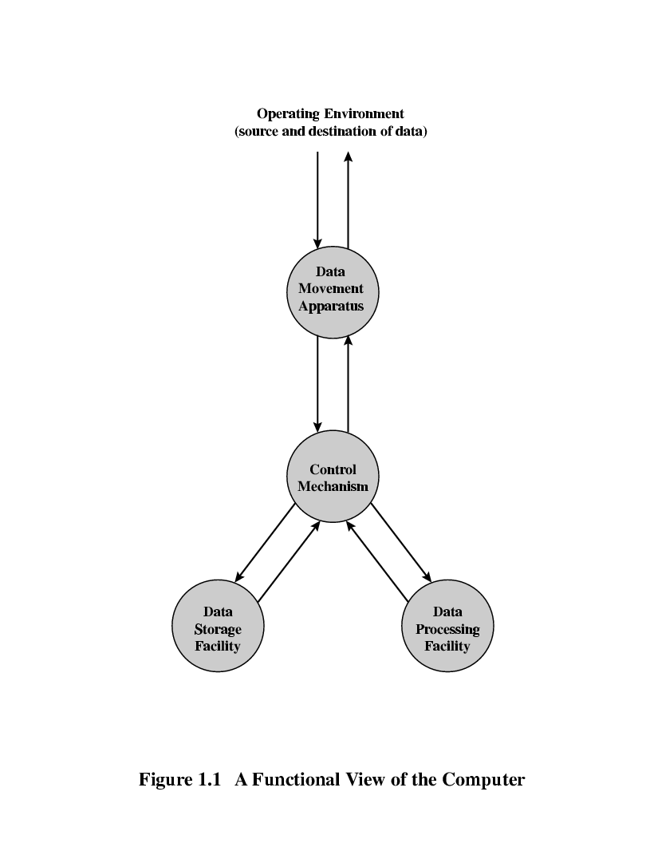
Functional View

Slide 10
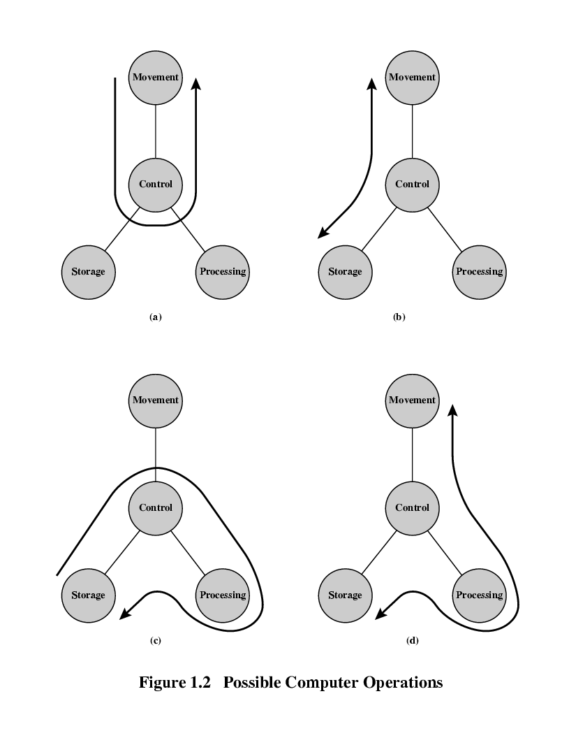
Operations (a) Data movement
The computer must be able to move data between itself and the outside world.

Slide 11
Operations (a) Data movement
When data are received from or delivered to a device that is directly connected to the computer, the process is known as input–output (I/O), and the device is referred to as a peripheral.
When data are moved over longer distances, to or from a remote device, the process is known as data communications.

Slide 12
Operations (b) Storage
The computer must temporarily store at least those pieces of data that are being worked on at any given moment.

Slide 13
Operation (c) Processing from/to storage

Slide 14
Operation (d) Processing from storage to I/O
The data may take a wide variety of forms, and the range of processing requirements is broad.
Files of data are stored on the computer for subsequent retrieval and update.

Slide 15
Control the three functions
Finally, there must be control of these three functions.
Ultimately, this control is exercised by the individual(s) who provides the computer with instructions.
Within the computer, a control unit manages the computer’s resources and orchestrates the performance of its functional parts in response to those instructions.

Slide 16
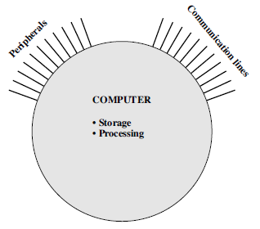
Structure
This figure is the simplest possible depiction of a computer.

Slide 17
Structure
The computer interacts in some fashion with its external environment.
In general, all of its linkages to the external environment can be classified as peripheral devices or communication lines.

Slide 18
Structure - Top Level
Peripherals
Computer
Central
Processing
Unit
Main
Memory
Computer
Systems
Interconnection
Input
Output
Communication
lines

Slide 19
Structure - The CPU
CPU
Computer
Arithmetic
and
Login Unit
I/O
Registers
System
Bus
CPU
Internal CPU
Interconnection
(Bus)
Memory
Control
Unit

Slide 20
Structure - The Control Unit
Control Unit
CPU
Sequencing
Login
ALU
Internal
Bus
Control
Unit
Control Unit
Registers and
Decoders
Registers
Control
Memory

Slide 21
Main structural components
Central processing unit (CPU) controls the operation of the computer and performs its data processing functions; often simply referred to as processor.
Main memory stores data.
I/O moves data between the computer and its external environment.
System interconnection some mechanism that provides for communication among CPU, main memory, and I/O e.g. system bus.

Slide 22
Main structural components
CPU is the most interesting and the most complex component.
Its major structural components are as follows:
  Control unit (CU) controls the operation of the CPU and the computer.
  Arithmetic and logic unit (ALU) performs the computer’s data processing functions.
  Registers provides storage internal to the CPU
  CPU interconnection some mechanism that provides for communication among the control unit, ALU, and registers.

Slide 23
Outline of the Course - CS323
We will cover the following chapters of our course:
  Computer Evolution and Performance
  A top-level view of computer function and interconnection
  Cache memory
  Internal Memory
  External Memory
  Input/Output
  Operating Systems Support
  Computer Arithmetic

Slide 24
Internet Resources - Web site for book
http://WilliamStallings.com/COA/COA7e.html
  links to sites of interest
  links to sites for courses that use the book
  errata list for book
  information on other books by W. Stallings
http://WilliamStallings.com/StudentSupport.html
  Math
  How-to
  Research resources
  Misc

Slide 25
Internet Resources - Web sites to look for
WWW Computer Architecture Home Page.
CPU Info Center.
Processor Emporium.
ACM Special Interest Group on Computer Architecture.
IEEE Technical Committee on Computer Architecture.
Intel Technology Journal.
Manufacturer’s sites:
  Intel, IBM, etc.

Slide 26
Internet Resources - Usenet News Groups
comp.arch
comp.arch.arithmetic
comp.arch.storage
comp.parallel
Next task:
Computer History
http://www.computerhistory.org/timeline

